Slide 1

Build Anything by JavaScript
Davy Chhouk
AUG, 2019

Slide 2

A little bit about me
B.S. Software Engineering College of Arts, Media and Technology of Chiang Mai University
Currently Developer Mango Byte Technology
Chhouk Davy
Email: chhouk.davy@gmail.com
Medium: https://medium.com/@davy.chhouk

Slide 3
Content 1
It’s JavaScript
A bit of History on JavaScript
ECMAScript
TypeScript
Node.js and NPM
Development Stack
Front-End Web Development
Progressive Web App (PWA)

Slide 4
Content 2
Mobile Application Development
Desktop Application Development
Back-End Development
IoT Development
Learning with JavaScript
Insights 2019
Conclusion
Question & Answer

Slide 5
Let’s go… It’s JavaScript!

Slide 6
It’s JavaScript
JavaScript
is a scripting or programming language that allows you to implement complex things on web pages — displaying timely content updates, interactive maps, animated 2D/3D graphics, scrolling video jukeboxes, etc.
--- developer.mozilla.org

Slide 7
It’s JavaScript
JavaScript
is a single threaded, non-blocking, asynchronous, concurrent, dynamic scripting programming language.
-- a more nerd-ist definition
Philip Roberts Talk on JSConf: https://2014.jsconf.eu/speakers/philip-roberts-what-the-heck-is-the-event-loop-anyway.html

Slide 8
It’s JavaScript
In action: http://latentflip.com/loupe
Notes:
http://latentflip.com/loupe/?code=ZnVuY3Rpb24gYWJjIChhLCBiLCBjKSB7CiAgICByZXR1cm4gYSAqIGIgKiBjOwp9Cgp2YXIgYSA9IDEsIGIgPSAyLCBjID0gMzsKCmZ1bmN0aW9uIHByaW50ICgpIHsKICAgIGNvbnNvbGUubG9nKGFiYyhhLCBiLCBjKSk7Cn0KCnByaW50KCk7!!!PGJ1dHRvbj5DbGljayBtZSE8L2J1dHRvbj4%3D

Slide 9
A bit of history on JavaScript

Slide 10

A bit of History on JavaScript
Birth WWW (1989) by Tim Berners-Lee
Creation of Browsers in the early days
NCSA Mosiac
Mosiac Netscape
Internet Explorer
The Birth of Mocha in 2 weeks (10 days) by Brendan Eich (1995)
Renaming of Mocha to LiveScript and again to JavaScript

Slide 11
A bit of History on JavaScript
Creation of more browsers / JavaScript Implementations / JavaScript Engines
Standardizing JavaScript @ Ecma International
Post Node.js JavaScript
HTML + CSS + JS
jQuery
Node.js
NPM
Better development tools (babel, webpack…)
Post Node.js JavaScript: Today!

Slide 12
ECMAScript

Slide 13
ECMAScript
Problems of JavaScript
Multiple Browsers using Different
JavaScript Engines.
V8 (Chrome/New Edge)
Spider Monkey (Firefox)
Nitro Engine (Safari)
Chakra Engine (Edge)

Slide 14

ECMAScript
What is ECMAScript?
ECMA International is a standards organization for information and communication systems in Europe.
ECMA International standardized a scripting-language in ECMA-262 and ISO/IEC 16262 and called it ECMAScript.
ECMA = European Computer Manufacturers Association

Slide 15
ECMAScript
Published ECMAScript
ES1 (1997)
ES2 (1998)
ES3 (1999)
ES4 (Abandoned)
ES5 (2009)
ES6/ES2015 (2015)
ES2016 (2016)
ES2017 (2017)
ES2018 (2018)
ESNEXT
Supports: https://kangax.github.io/compat-table

Slide 17
TypeScript

Slide 18
TypeScript
JavaScript that scales.
TypeScript typed superset of JavaScript that compiles to plain JavaScript.
Any Browser. Any Host. Any OS. Open Source.

Slide 19
TypeScript
Transpiling

Slide 20
TypeScript
https://www.typescriptlang.org/play/index.html

Slide 21
Node.js

Slide 22

Node.js
A JavaScript run-time built on Chrome’s V8 JavaScript Engine.
Initial Release: May, 2009
Author: Ryan Dahl
Platforms: Linux, macOS, Windows, and more.

Slide 23
Node.js

Slide 24
Node.js
What does it mean?
Enabling JavaScript outside of Browser
JavaScript for both Client and Server Side
Development Efficiency (Fill Gap between Front-End and Back-End)
A lot of Tools and Frameworks were possible relying on Node.js
Recommended Book: Node.js Web Development: Server-side development with Node 10 made easy, 4th Edition
By: David Herron https://www.amazon.com/Node-js-Web-Development-Server-side-development/dp/1788626850

Slide 25
Node.js
Best features of Node.js
Fast
Simple
JavaScript
V8 / libuv
Asynchronous and Non-Blocking using Single Thread, Callback Function, and Event-Driven Programing
Tons of Libraries

Slide 26

NPM
Node Package Manager
Enabling of Code Sharing Globally
11 millions Users and Growing Fast
Package Downloads: Around 6 Billion/Week
Open Source Projects

Slide 27
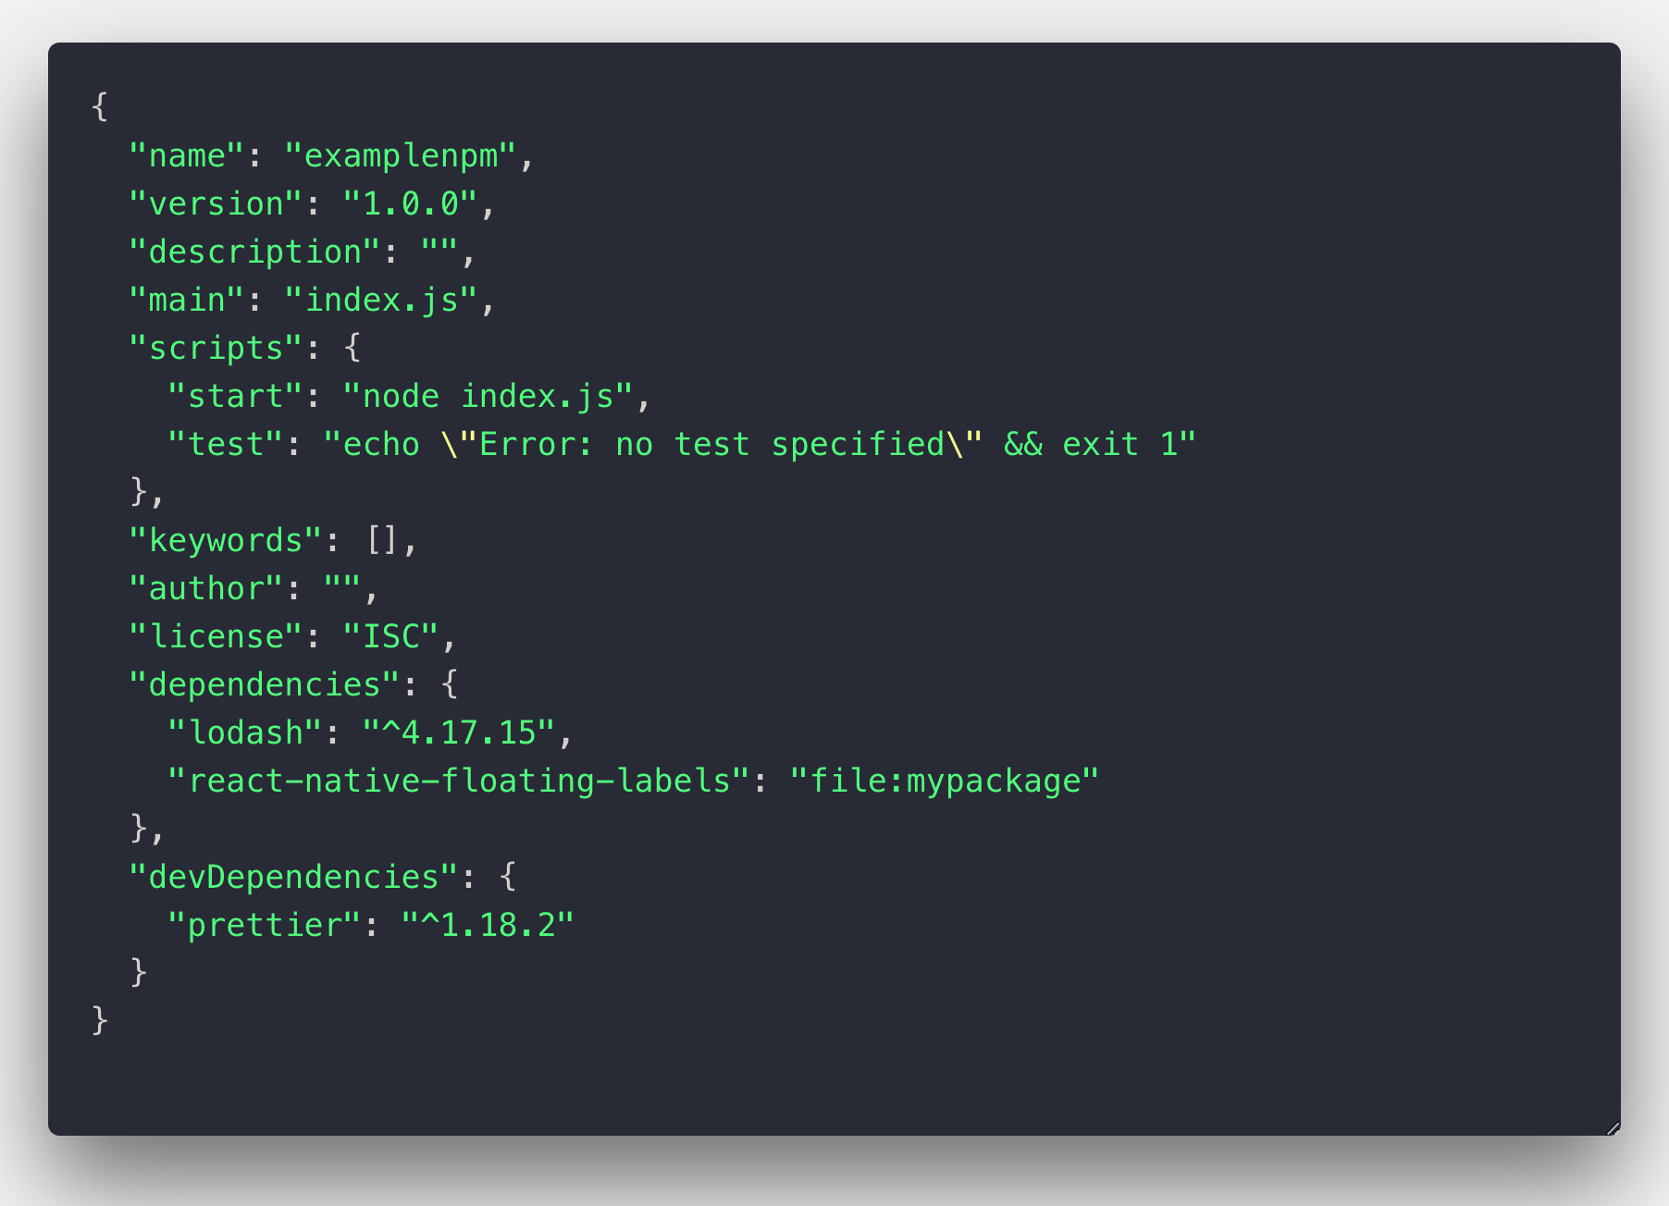
Package.json Example

Slide 28
NPM
Tips on NPM
What to do when you use NPM package and it does not behave like you want / bug / error?
Report issue(s) in github
Build your own package
Clone the package and modify / fix / adjust
Use it as a local package / from your repository
Pull Request / use new version
Example: https://www.npmjs.com/package/react-native-floating-labels https://www.npmjs.com/package/react-native-voice

Slide 29
Font-End Development

Slide 30

Front-End Web Development - Vanilla JavaScript
Plain JavaScript without using additional library or framework
There are tons of libraries/frameworks out there so we tend to use those when we don’t really need them. Rethink if we really need to.

Slide 31

Front-End Web Development - jQuery
jQuery Object and allowing own extensions and plugins without having to worry about the cross browsers supports
Easy DOM Element access and standardized across browsers
Standardized Even Handlers
Made simple animation easier
Standardized AJAX across browsers

Slide 32

Front-End Web Development - Angular
Angular is NOT Angular.js
Popularity: 50k+ Github Stars
Using TypeScript
Backed by Google
One Whole Solution Package
Opinionated Structured
Separation of Concern (SoP)
Two-Way Data Binding
Dependency Injection
Come with good CLI

Slide 33

Front-End Web Development - React.js
Popularity: 135k+ Github Stars
Backed by Facebook
Lighter weight, Fast and Scalable
Freedom
Only use what you need
Structure as you like
Tons of Support Libraries, Tools and other resources
JSX – JavaScript eXtension
create-react-app CLI

Slide 34

Front-End Web Development - Vue.js
Popularity: 146k+ Github Stars
Good Parts of (Angular + React)
Lightweight, Fast and Scalable
Shallow Learning Curve
Main support libraries like Vue Router, Vuex are built by Vue Core Team
Freedom
Only use what you need
Structure as you like
Come with good CLI

Slide 35
Mobile Application Development

Slide 36

Progressive Web App (PWA)
PWA are websites that offer modern web capabilities to deliver an app-like experience to user.
Reliable: Load instantly and never show the downasaur, even in uncertain network conditions.
Fast: Respond quickly to user interactions with silky smooth animations and no janky scrolling.
Engaging: Feel like a natural app on the device, with an immersive user experience.

Slide 37
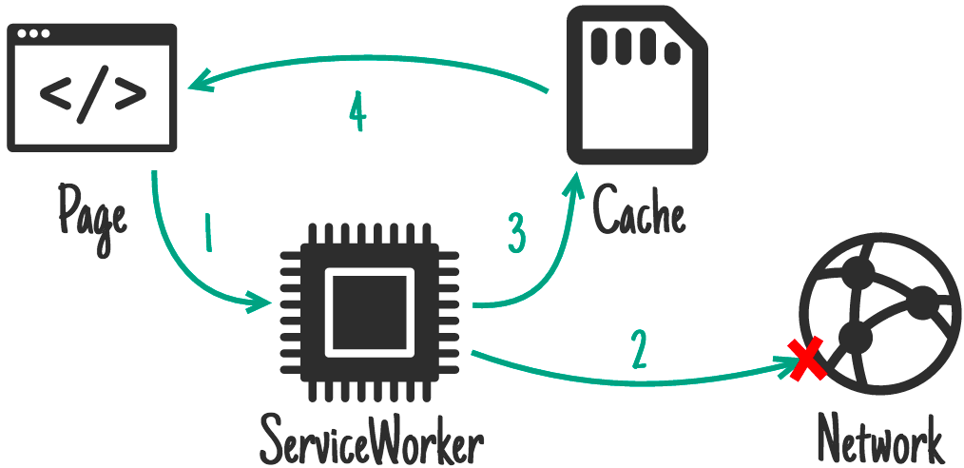
Progressive Web App (PWA)
Service Worker
Proxy between the Browser and Network
Offline first using Caching API

Slide 38
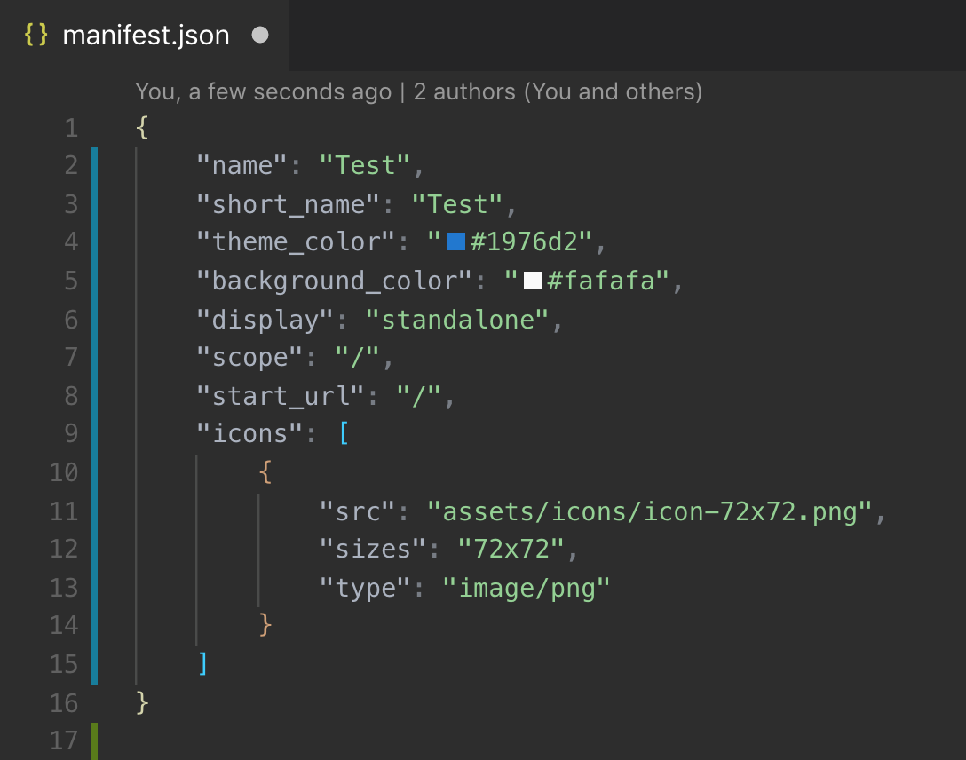
Progressive Web App (PWA)
Manifest – PWA Properties Declaration

Slide 39



Hybrid Mobile Application Development
WebView Mobile Application
Web Components
One Code Base for Web and App
Easy to Convert into PWA
Abundance of UI Components
Faster Development Time and Less Resources
Update Over The Air
PhoneGap
Cordova
Ionic

Slide 40
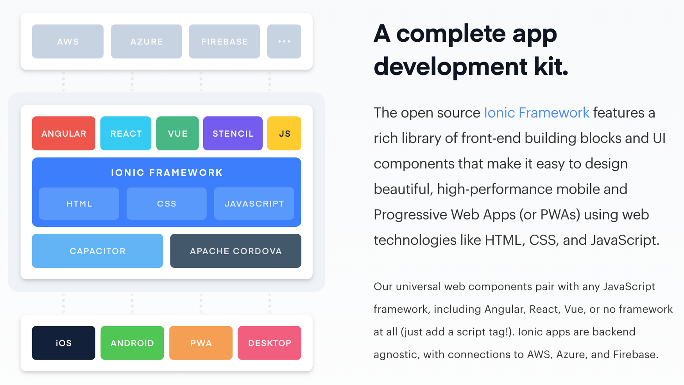
Hybrid Mobile Application Development

Slide 41
Mobile Application Development with React-Native
Hybrid Native Application (Native App NOT WebView App)
Popularity: 80k+ Github Stars
Backed by Facebook
Indistinguishable Usage Experience from Native Application
Performance is Native-Like Application
Matured Eco System
Abundance of Resources and Development Tools
Update Over The Air

Slide 42

Mobile Application Development with Native Script
Hybrid Native Application (Native App NOT WebView App)
Popularity: 17k+ Github Stars
Indistinguishable Usage Experience from Native Application
Performance is Native-Like Application
Develop using Angular or Vue
UI Components

Slide 43
Desktop Application Development

Slide 44

Desktop Application Development with Electron.js
Electron.js is a framework for creating native applications with web technology.
“If you can build a website, you can build a desktop app.”
Popularity: 76k+ Github Stars
Built and Backed by Github Developers
Based on Node.js and Chrome’s V8
Cross-Platforms (Windows/Linux/MacOS)
Grow a long side web technologies

Slide 45
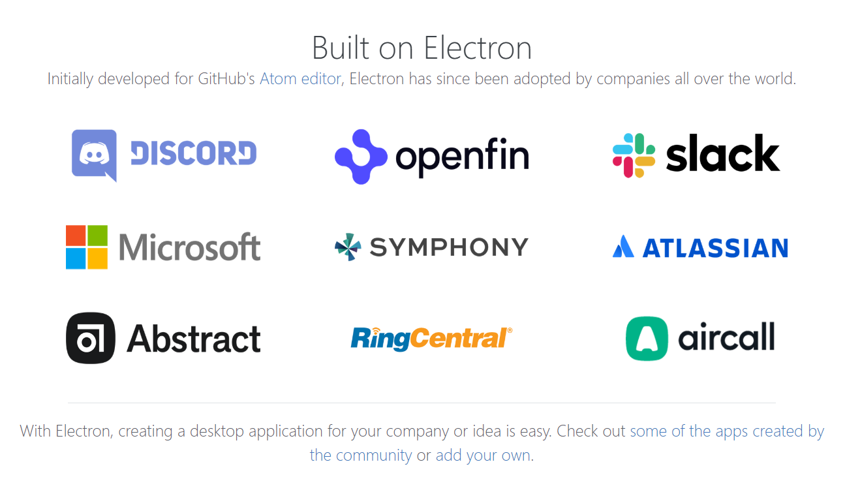
Desktop Application Development with Electron.js

Slide 46
Back-End Development

Slide 47

Back-End Development with Express
Fast, Unopinionated, Minimalist Web Framework for Node.js
Popularity: 45k+ Github Stars
Lower Learning Curve
Great 3rd Party Integration
Thin Layer up on Node.js
https://expressjs.com

Slide 48

Back-End Development with Meteor.js
Full Stack JavaScript platform for developing modern web and mobile application.
Popularity: 41k+ Github Stars
Full Stack Solution
Real-time Web Application
Custom Package Manager
https://www.meteor.com

Slide 49
Back-End Development with Sails.js
Sails makes it easy to build custom,
enterprise-grade Node.js app.
Popularity: 20k+ Github Stars
Full MVC
Autogenerated REST APIs
Any Database
https://sailsjs.com

Slide 50
Back-End Development with Nest.js
A progressive Node.js framework for building efficient, reliable and scalable server-side application.
Popularity: 18k+ Github Stars
Dependency Injection
Modularization
Inspired by Angular
https://nestjs.com

Slide 51
Video Games

Slide 52

Video Games
Powerful, beautiful, simple,
open web-based 3D at its best WebGL.
Demo: https://www.babylonjs.com/demos/sponzadynamicshadows/
Popularity: 9.9k+ Github Stars
https://www.babylonjs.com/

Slide 53
Video Games
Impact is a JavaScript Game Engine that allows you to develop stunning HTML5 Games for desktop and mobile browsers.
https://impactjs.com/

Slide 54
IoT

Slide 55
IoT Development using JavaScript
What is IoT?
Physical objects with embedded electronics, sensors, and software connected to the internet.
JavaScript for these Devices?
JavaScript only Microcontrollers E.g. Tessel 1, Espriuno, ESP8266/NodeMCU
Embedded Linux Devices E.g. Tessel 2, Raspberry Pi, C.H.I.P
Hybrid Solutions E.g. Host Computer + Microcontroller + Johnny Five
Source: https://youtu.be/KS6GxMOJjA8

Slide 56
Learning with JS

Slide 57
Machine Learning using JavaScript
What is Machine Learning?
Machine learning is an application of artificial intelligence (AI) that provides systems the ability to automatically learn and improve from experience without being explicitly programmed.
Python!!! How about JavaScript?
TensorFlow.js
Brain.js (For Neural Networks)
Deeplearnjs
mljs

Slide 58
Chatbot

Slide 59
Chatbot
The open-source Conversational Platform with built-in language understanding (NLU), beautiful graphical interface and dialog manager. Easily create chatbots and AI-based virtual assistants.
Popularity: 7.5k+ Github Stars
https://botpress.io

Slide 60
Insights

Slide 61
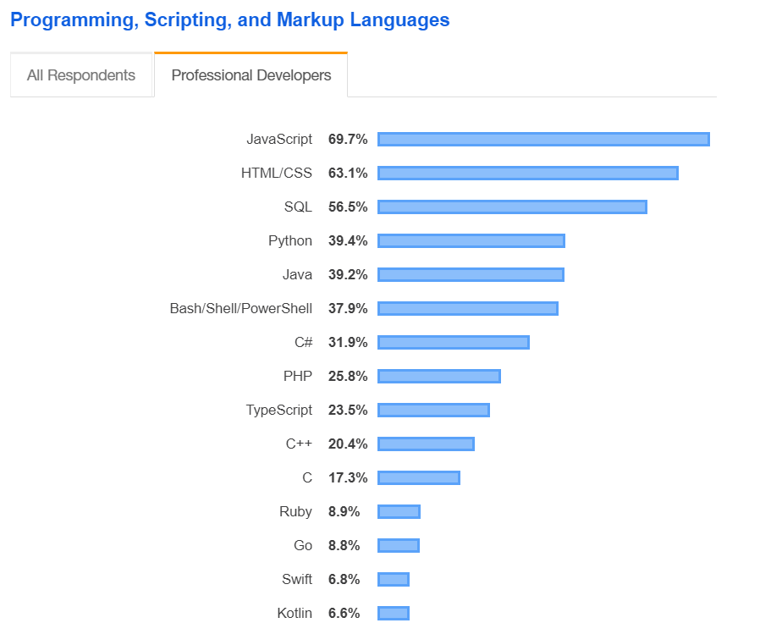
Statistic on JavaScript
Stack Overflow Developer Survey 2019

Slide 62
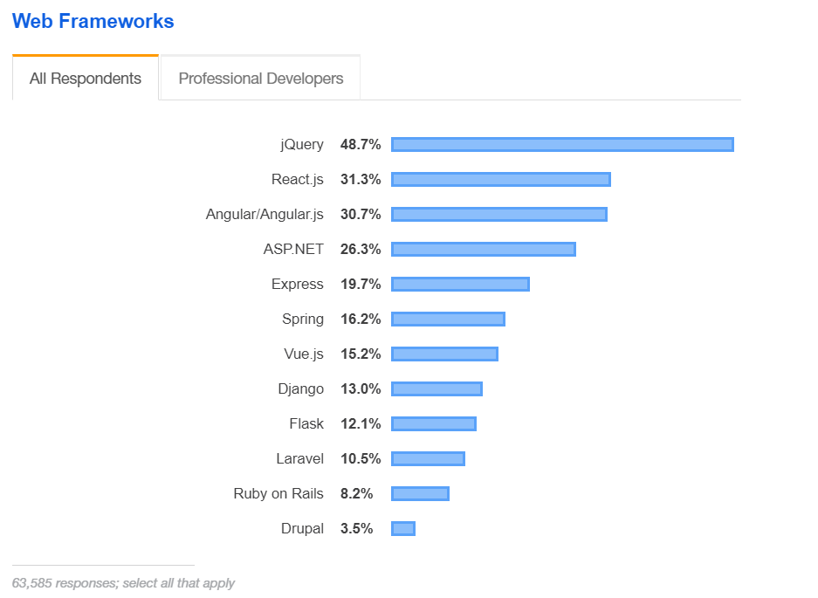
Statistic on JavaScript
Stack Overflow Developer Survey 2019

Slide 63
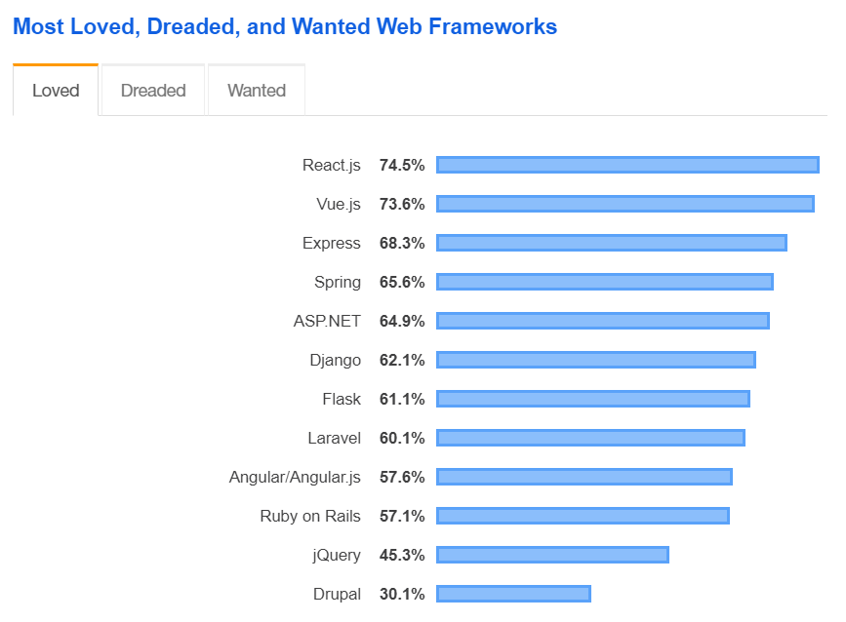
Statistic on JavaScript
Stack Overflow Developer Survey 2019

Slide 64
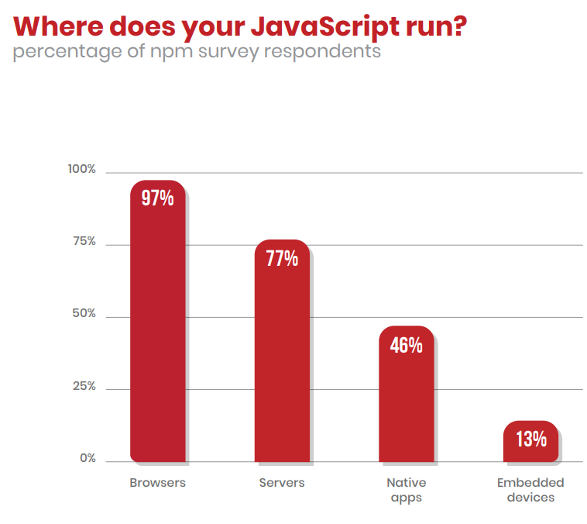
Statistic on JavaScript
Enterprise JavaScript - NPM Survey 2019

Slide 65
That’s about it.

Slide 66
Q&A

Slide 67

Slides: https://github.com/davychhouk/js-talk-wp-community

Slide 68
Thank you…

